Slide 1


Automatic Computer Science Phrase Extractor : Model Visualization
S M Abrar Jahin

Slide 2



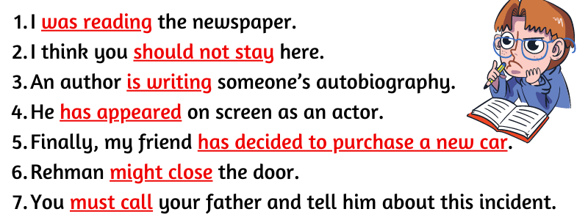
Problem Formulation

Slide 3
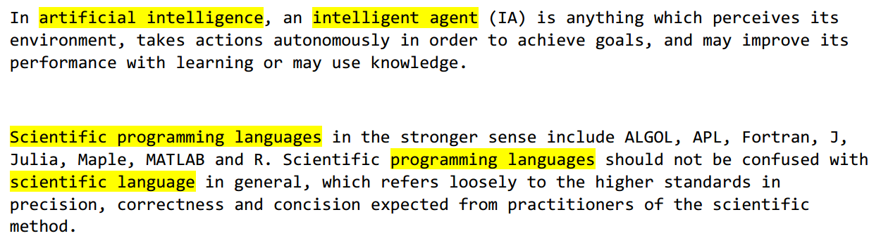
Problem Formulation: Contd.

Slide 4
Existing Algorithms For Extracting Keywords
Frake
Rake
Yake
Keybert
PKE

Slide 5
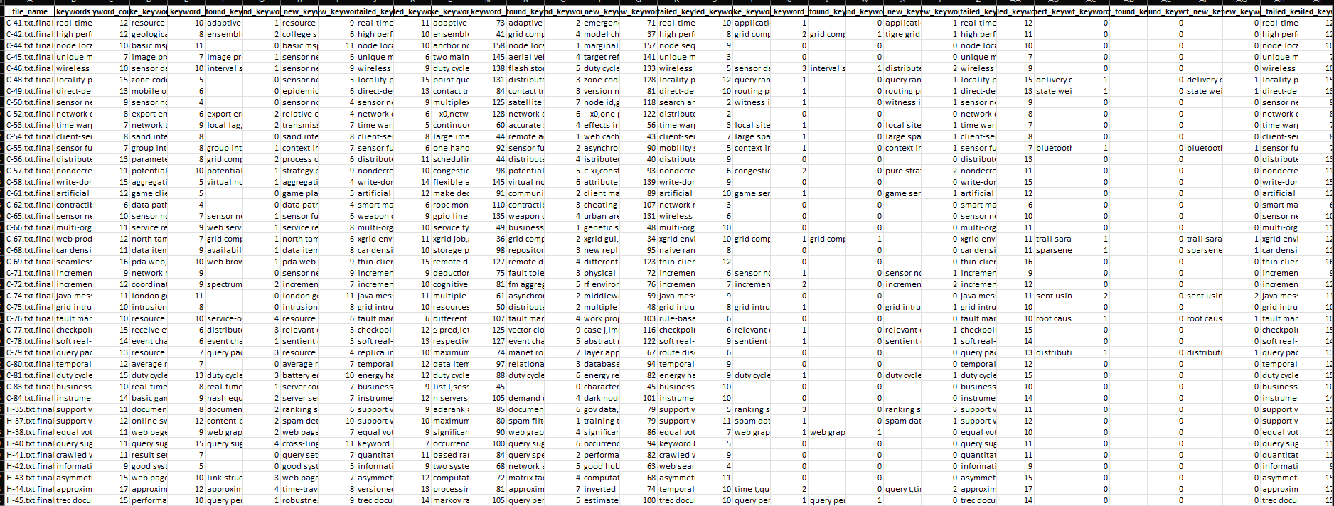

Our Current Work: Why Rake?
Dataset - SemEval2010

Slide 6
Proposed Algorithm
Input
1
2
3
4
Sentence/Paragraph
Remove all special characters
Replace special hyphen with ascii hyphen
Remove all Non-ASCII Chars
Extract Acronym
Remove Grammatically Incorrect Phrases By AI based Parts of Speech Tagger Association Rule
Remove Keywords and keep only Phrases
Extract Phrases with Hyphen
Extract Phrases with Rake
7
6
5
8
Deep Learning Models
Remove Grammatically Unimportant Phrases By Deep Learning based Word Stemming Rule
Create Embedding of the existing phrases
Apply Binary Classifier Deep learning model to find the CS phrases
List of CS Phrases
11
Output
9
10

Slide 7
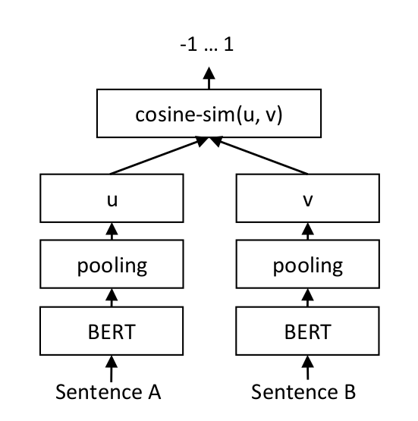
Embedding Creation
Use Pre-Trained BERT
Train Polarity with hand labeled 2500 phrases
Used Cosine Similarity as Triplet Loss

Slide 8
Binary Classification Model
Input Size
768
550
300
Dropout
80
1
Embedding
Output Label
ANN Model
Rectified Linear Unit (ReLU) as Activation Function
Used Binary Cross Entropy Loss as loss function
Adam optimizer for optimization

Slide 9
Future Work
Train the model with more data
Improve the accuracy of the algorithm

Slide 10


Slide 11


